Slide 1
Ideal Restaurant Spot Finder

Slide 2
Predicting the ideal spot for restaurant
Bus stations are ideal locations for small businesses to set up shops.
Each person in this flow of foot traffic is a potential customer.
Commuters who travel by bus are often in a hurry and are in need of food that can be prepared and consumed fast in order to reach their destination quickly.

Slide 3
Data acquisition and processing
Neighborhood names containing all the pincodes of India(Source: https://data.gov.in/resources )
After extracting neighborhoods of Mumbai, the relevant data is saved into a DataFrame.
Duplicate, highly similar or highly correlated features were dropped.
Venue data is found out bypassing in the required parameters to the FourSquare API.

Slide 4
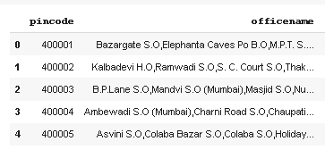

Slide 5
Methodology
A detailed analysis of the principles of methods and rules employed have been made in order to ensure the inferences to be made are as accurate as possible.
Coordinates are identified based on various geocoders.
Visualization of maps using mapping strengths of leaflet.js

Slide 6
Results
The neighbourhoods are divided into n clusters where n is the number of clusters found using the optimal approach.
The clustered neighbourhoods are visualized using different colours so as to make them distinguishable.

Slide 7
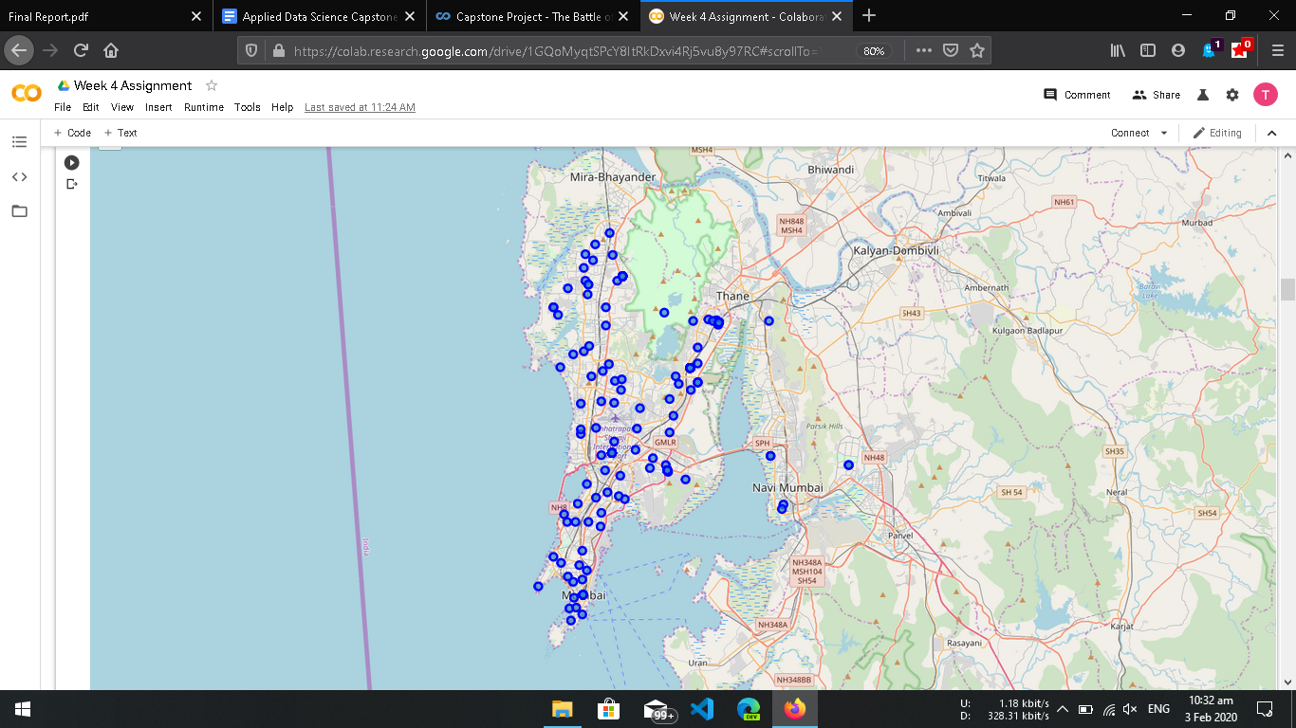
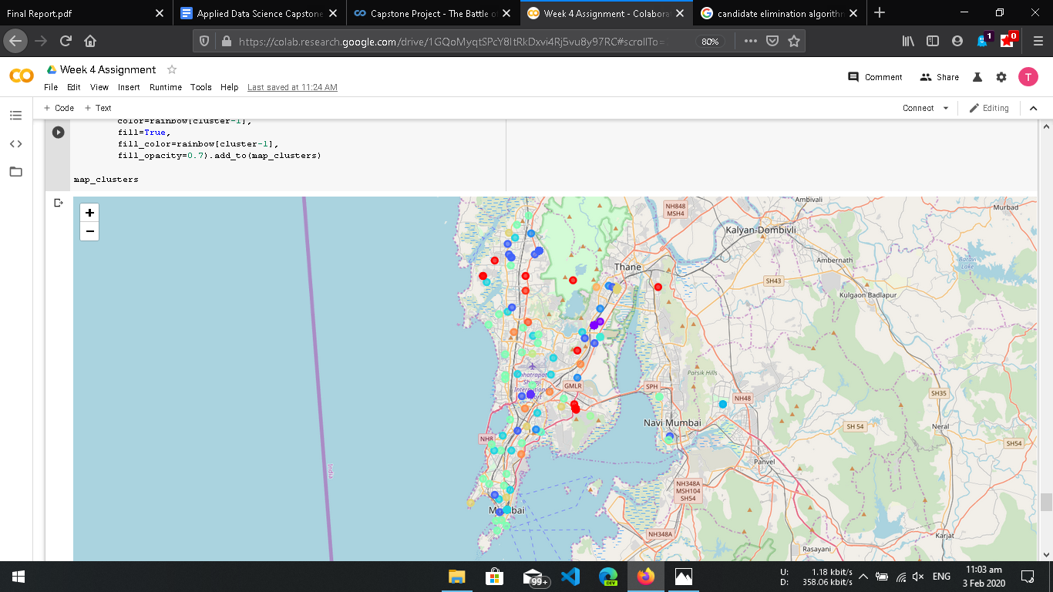

Slide 8
Conclusion
Cluster no. 6 is a prime fit to solving the problem of finding a cluster with common venue as a bus station.
The demographic of the population in these areas fall under the lower middle class of the society.
Opening food outlets catered for that section of the society will see a massive increase in footfall, which would lead to a further increase in business.

Slide 9
THANK YOU

